Slide 1
HTML and CSS Course
Arabic Edition – باللغة العربية
Presented By: Ramy Ibrahim

Slide 2
Course Outlines
Introduction
HTML Fundamentals
CSS Fundamentals

Slide 3
Before we start
Please Practice.
Programming studying is different.
Memorization Problem.
Main concepts (Algorithms, Data structure, and Design Patterns).
Love the bugs you found.
Take breaks (Release mode).
2hrs, 15mins(break), 1hr, 15mins(break), 30mins.

Slide 4

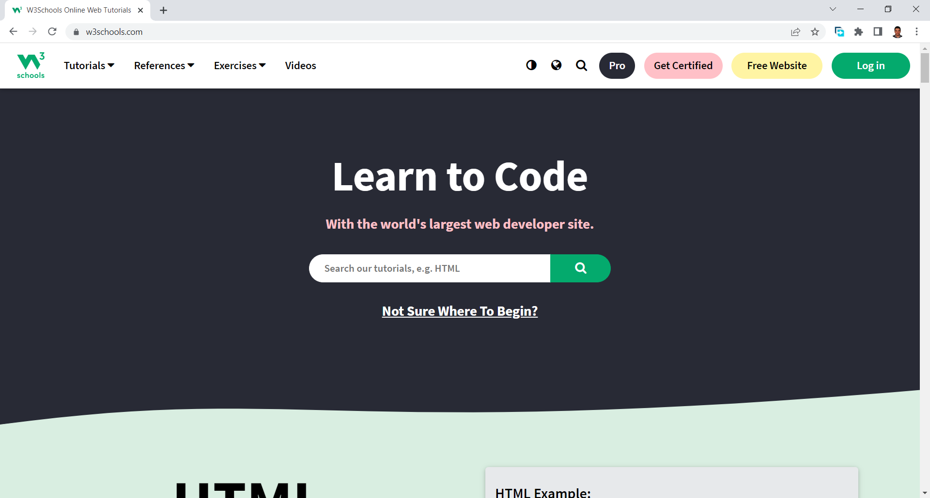
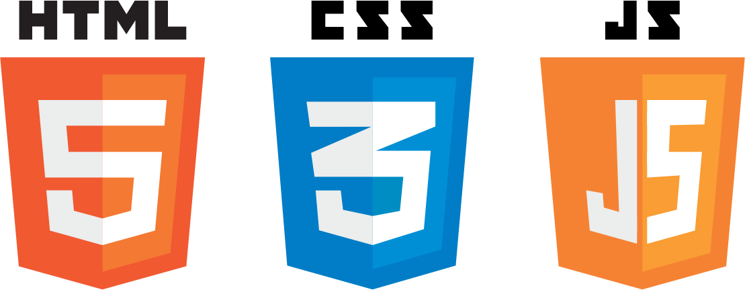
Introduction
What is the story?
HTTP GET Request
HTTP Response
Web Client
Web Server

Slide 5
HTTP Request Journey
Internet is a Network
IP Address
Domain Name: www.w3schools.com
IP Address: 76.223.115.82
Domain Name Server
DNS
HTTP GET Request to (76.223.115.82)
Web Client
HTTP Response (200)
Try to Ping
Web Server

Slide 6

Response Journey
Rendering
HTTP GET Request to (76.223.115.82)
Data base server
HTTP Response (200)
Web Server
3rd parties
Web Client
Dynamic Site
Static Site

Slide 7


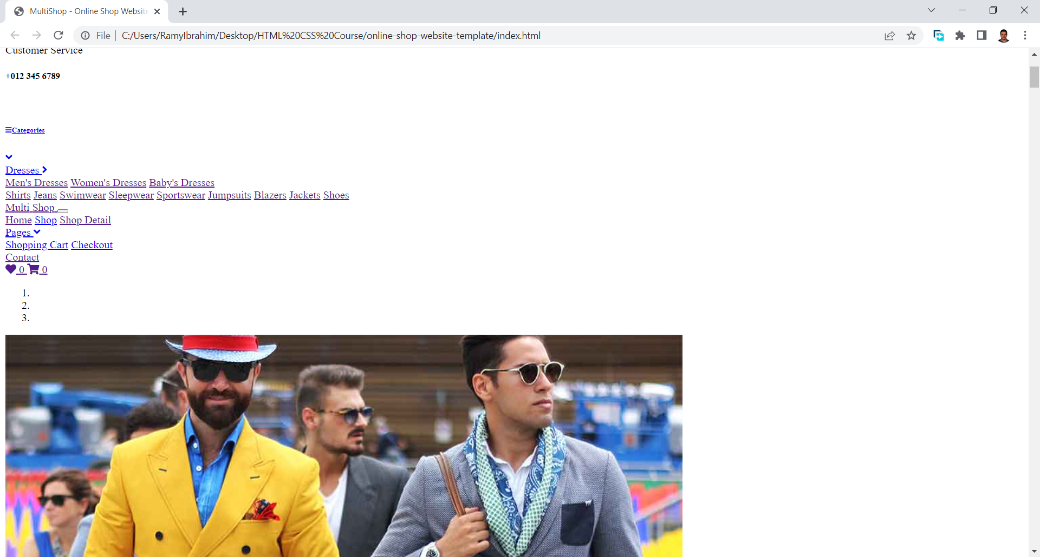
HTML, CSS, and JS
HTML : Content
CSS: Presentation
JS: Actions, Content edit,
Data requests, browser functions
Timers, etc.…

Slide 8
Web Design vs Web Development

Slide 9
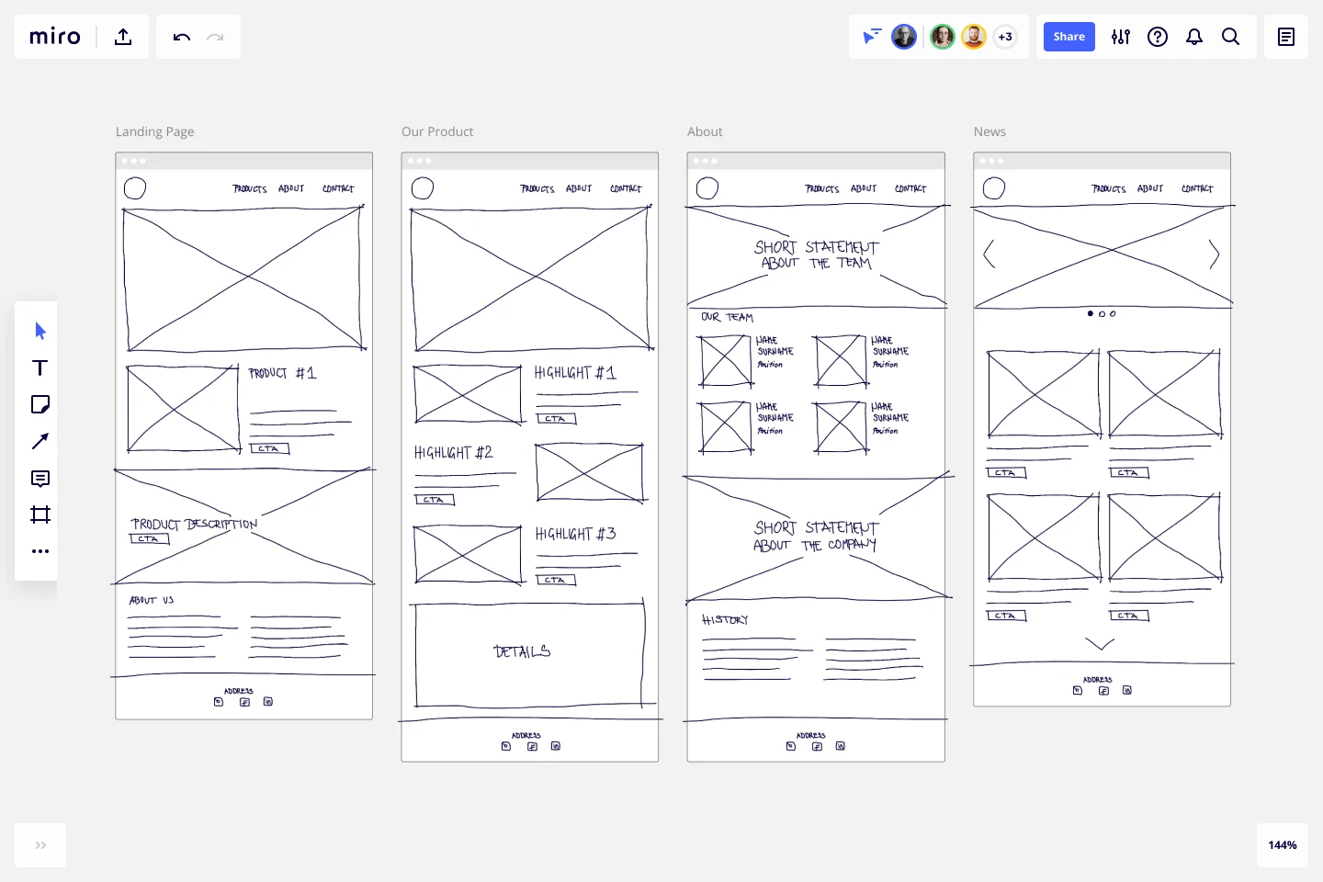



Web design
Create web layouts
Logo design
Graphic Design
Font Selection
Responsive Design
Wireframes
User experience

Slide 10








Web development
Front-end Development
Back-end Development
Database-design

Slide 11
Different approaches to web development
Embedded code
MVC
API
Front, Back
PHP
JSP
ASP
ASP.net
Laravel
Spring
ASP.net MVC
ASP.net web API
Laravel
Spring
Angular
React
VUE
Remove Redundancy
Mobile Development
Logic Separation

Slide 12
Environment setup
Visual studio code
Extensions:
Live server
Prettier
Auto rename tag
Chrome developer tools
Lighthouse extension
Settings
Auto-close tag
Default formatter

Slide 13
E-Commerce Project
overview

Slide 14
HTML Section
Presented By: Ramy Ibrahim

Slide 15
What is HTML
Hyper- text markup language
Not a programming language
Markup like XML (Extensible Markup Language)
Contains Elements = Tags
HTML Versions
HTML
HTML5

Slide 16
HTML VS HTML5
HTML5 supports audio and video.
HTML5 supports new types of form controls, such as date and time, email, number, category, title, Url, search, etc.
Many elements have been introduced in HTML5. Some of the most important are time, audio, description, embed, fig, shape, footer, article, canvas, navy, output, section, source, track, video, etc.

Slide 17
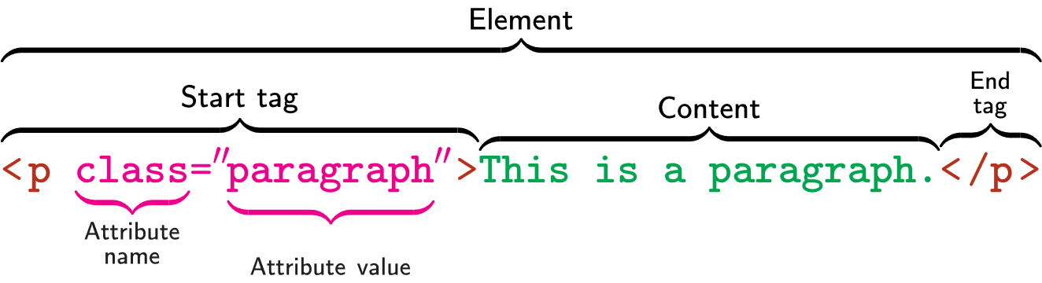
HTML Element
https://developer.mozilla.org/en-US/docs/Web/HTML/Element
https://www.w3schools.com/html/html_basic.asp

Slide 18
Basic Elements
HTML Tags
Text Elements
Images
Hyperlinks
Tables
Head & Meta
DIV & Span

Slide 19
Block element vs inline elements
Inline Elements | Block Elements
Inline elements occupy only sufficient width required. | Block Elements occupy the full width irrespective of their sufficiency.
Inline elements don’t start in a new line. | Block elements always start in a line.
Inline elements has White-space problem | Block elements with float don’t have white-space problem
Inline elements don’t have top and bottom margin | Block elements doesn’t allow other elements to sit behind

Slide 20
HTML5 Structure elements (Semantic)
Header
Nav
Section | Aside
Article
Footer

Slide 21
Forms input Elements
<form> Defines an HTML form for user input
<input> Defines an input control
<textarea> Defines a multiline input control (text area)
<label> Defines a label for an <input> element
<fieldset> Groups related elements in a form
<legend> Defines a caption for a <fieldset> element
<select> Defines a drop-down list
<optgroup> Defines a group of related options in a drop-down list
<option> Defines an option in a drop-down list
<button> Defines a clickable button
<datalist> Specifies a list of pre-defined options for input controls
<output> Defines the result of a calculation

Slide 22
CSS Section
Presented By: Ramy Ibrahim

Slide 23
What is CSS
Cascading Style Sheet
Visual Representation
Consists of powerful rules to format everything in the page content(HTML tags)

Slide 24
CSS Rule
Declaration Block { }
Selector
h1 {
font-size: 16px;
font-weight: bold;
}
Declaration
Property
Value

Slide 25
Topics to Develop
Inline, Internal and External Styling
Basic Text Styling
Image Styling
Auto height
Object-fit:Cover
Borders
Hyperlinks
Selectors
Single
Multiple
All children inside parent selector
Direct children inside parent selector
Combining Selectors with Common Properties
Use of ID and Class
Select by Pseudo classes

Slide 26
Conflicts between selectors
!important
Highest priority
Inline
2
ID
3
Class
4
Element
5
Universal *
6
All rules are applied

Slide 27
Inheritance
Some styles can be inherited by child's elements (Text styles are the most)
The rest cannot be inherited (Borders, Margin, Padding)
But Universal selector can be used to apply non-inheritable styles
Universal selector can be used to override default browser behavior
* {
margin: 0;
padding: 0;
}

Slide 28
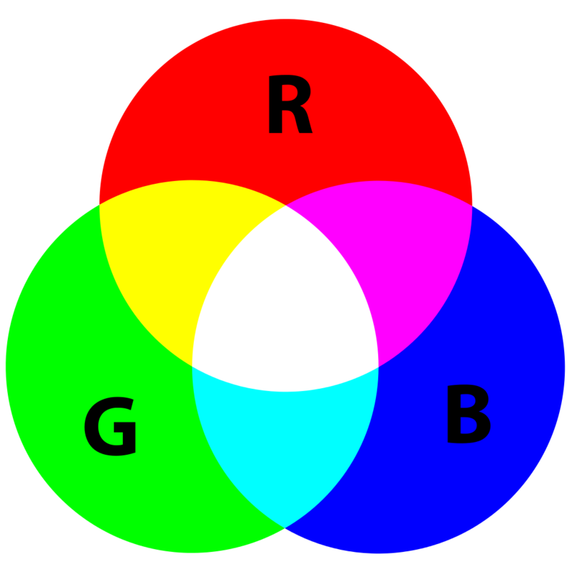
Working with Colors
All colors can be generated from 3 basic colors (RGB)
In CSS colors can be used in 2 forms
RGB / RGBA model rgb(255,0,12) rgb(12,12,12,0.5)
Hexadecimal Model #FF1122 #FFF
Color range starts from 0 to 255
Alpha range starts from 0 to 1
Grey colors are equal in the 3 values
In practice we use hexadecimal model and rgba

Slide 29
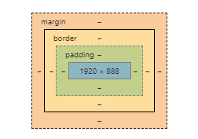
Box model, Margin and Padding
Margin
Padding
Box Model
Centering content with auto margin
Margin collapsing

Slide 30
Inline, Block and Inline-Block
Block Elements | Inline Elements
Element width is 100% of it’s parent | Element width is the width that content can occupy
Elements are stacked vertically | Elements aligned next to each other
Box model is fully applied to the element | Box model is applied except top, bottom margins and padding. Height and width are not applied
Display: block | Display: inline
Body, main, header, footer, section, nav, aside, div, heading, p, ul, ol, li, etc | A, img, strong, em, button, etc
White spaces problem (0 font-size, display block, remove spaces)
Inline-blocks : inline from inside but block from outside

Slide 31
Positioning
Absolute
Elements are removed from normal flow (parent element will be empty)
No impact on surrounding elements
Position: absolute, (left, right, top, bottom)
Position is related to parent relative (view port problem)
Relative
Elements are in normal flow
Fixed
Elements are fixed to viewport

Slide 32
Pseudo Elements
::first-letter
::first-line
::before
::after (Clear fix)
::selection

Slide 33
Building Layouts
Ways to arrange components in HTML Page
Component layout vs Page layout
Ways to build layouts
Floats
Clear Fix
Box-sizing:border-box
Flex
Grid

Slide 34
Floats
Float same as absolute position but text and inline elements will wrap around the floated element
Box-sizing:border-size
Element collapse problem (clear both)

Slide 35
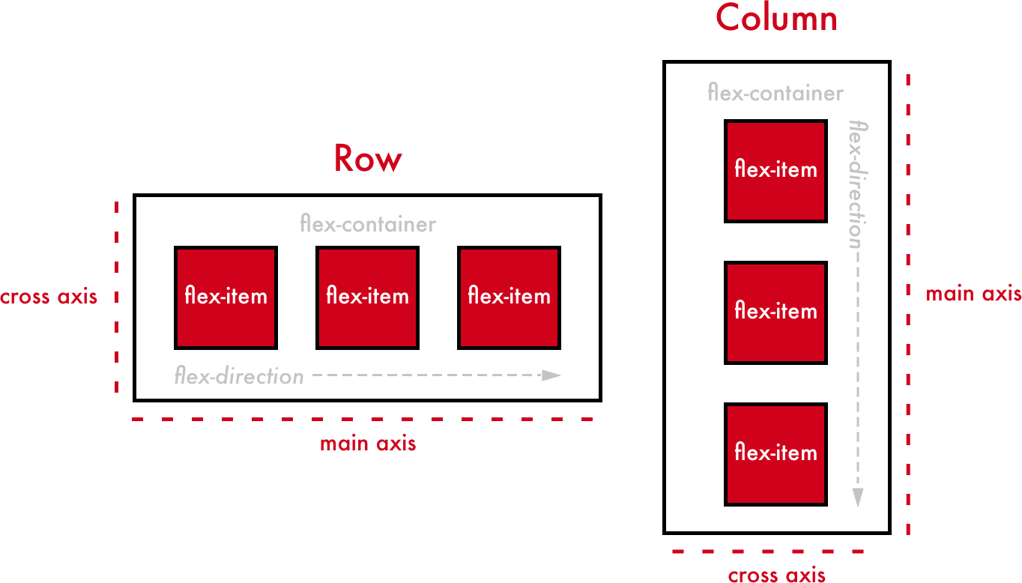
Flexbox
Flex boxes are used to build 1 dimension layout
Spaces will be automatically divided by child elements
Vertical alignments became very easy (problem without flexboxes)
Flexbox can replace floats

Slide 36
Flexbox properties
Flex container | Flex items
gap:0|<length> To create space between items, without using margin | align-self: auto | stretch | flex-start | flexend | center | baseline To overwrite align-items for individual flex items
justify-content: flex-start | flex-end | center | space-between | space-around | space-evenly To align items along main axis (horizontally, by default) | flex-grow: 0 | <integer> To allow an element to grow (0 means no, 1+ means yes)
align-items: stretch | flex-start | flex-end | center | baseline To align items along cross axis (vertically, by default) | flex-shrink: 1 | <integer> To allow an element to shrink (0 means no, 1+ means yes)
flex-direction: row | row-reverse | column | column-reverse To define which is the main axis | order: 0 | <integer> Controls order of items. -1 makes item first, 1 makes it last
flex-wrap: nowrap | wrap | wrap-reverse To allow items to wrap into a new line if they are too large | flex: 0 1 auto | <integer> <integer> <len> Recommended shorthand for flex-grow, -shrink, -basis.
align-content: stretch | flex-start | flex-end | center | space-between | space-around Only applies when there are multiple lines (flex-wrap: wrap) | flex-basis: auto | <length> To define an item’s width, instead of the width property

Slide 37
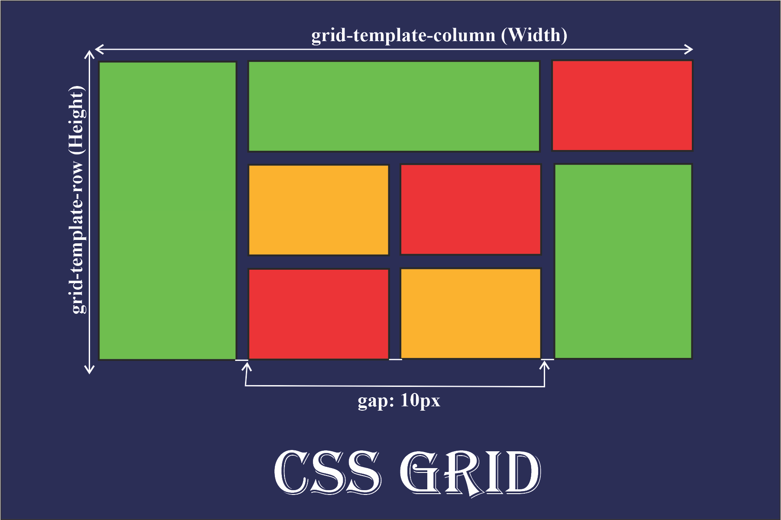
CSS Grid
CSS Grids are used to build 2 dimensional layouts
CSS Grids are used beside Flexboxes
CSS Grids divides container to rows and cols

Slide 38
CSS Grid
Grid Container | Grid Items
grid-template-rows: <size>* grid-template-columns: <size>* To establish the grid row and column tracks. One length unit for each track. Any unit can be used, new fr fills unused space | grid-column: <start line>/<end line> | span <number> grid-row: <start line>/<end line> | span <number> To place a grid item into a specific cell, based on line numbers. span keyword can be used to span an item across more cells
row-gap: 0 | <length> column-gap: 0 | <length> gap: 0 | <length> To create empty space between tracks | justify-self: stretch | start | center | end align-self: stretch | start | center | end To overwrite justify-items / align-items for single items
justify-items: stretch | start | center | end align-items: stretch | start | center | end To align items inside rows / columns (horizontally / vertically)
justify-content: start | start | center | end | ... align-content: start | start | center | end | ... To align entire grid inside grid container. Only applies if container is larger than the grid

Slide 39
Units
Absolute | Relative
cm centimeters mm millimeters in inches (1in = 96px = 2.54cm) px * pixels (1px = 1/96th of 1in) pt points (1pt = 1/72 of 1in) pc picas (1pc = 12 pt) | em Relative to the font-size of the element (2em means 2 times the size of the current font) ch Relative to the width of the "0" (zero) rem Relative to font-size of the root element vw Relative to 1% of the width of the viewport* vh Relative to 1% of the height of the viewport* % Relative to the parent element

Slide 40
Box Shadow
h-offset
v-offset
blur
spread
Color
box-shadow: 10px 10px 8px 10px #888888;

Slide 41
Variables
Variables in CSS are used to store values to be used in many properties
Using Variables is helpful in designing template with many themes
Variables can be declared in elements or globally in :root pseudo class
:root {
--main-bg-color: brown;
}
element{
background-color:var(--main-bg-color)
}

Slide 42
Responsive design
It is the design that changes dynamically based on screen width or based on device type
Layout (ways to arrange components in the page) is changed based on screen width
CSS media queries are used to define custom CSS rules that apply during custom screen widths
Media queries can check:
width and height of the viewport
width and height of the device
orientation (is the tablet/phone in landscape or portrait mode?)
resolution

Slide 43
Responsive Design
@media not|only mediatype and (mediafeature and|or|not mediafeature)
Only is used to prevent old browser from applying style without restrictions.
Not used to invert the meaning of query
Media type: all | print | screen | speech (Used for screen readers)
MediaFeature: aspect-ration | orientation | height | width | max-height | max-width | min-height | max-width ,and many other features

Slide 44
Other Topics (during the practical implementation)
Font –awesome
Web Fonts
RTL
SASS , LESS (CSS Extensions)
Bootstrap
Transitions

